Slide 1

My Linear Relationships Interactive Notebook
Name
Class
Teacher
Semester 2
Term 4
1

Slide 2

Interactive Notebooks!
Cover Page
Contents Page
Glossary
24/7/30
EQ
Questions
Notes
Summaries
Work page
Presentation!!!
Your book, your responsibility!

Slide 3
Contents
Glossary or Formula Page
Page
Date
Description
For example
Linear: ___________
Origin: ___________
Coordinates: __________
2
3

Slide 4

24
7
30
Tasks
24
7
30
Essential Question
Complete the tasks on this side (left) of your page
You should be ticking these off!
Questions
Notes
Write your notes on this side (right) of your page
Summary
Have YOU been doing your summaries?
Your book, your responsibility!

Slide 5
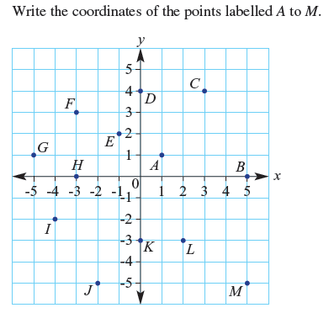

From last lesson

Slide 6
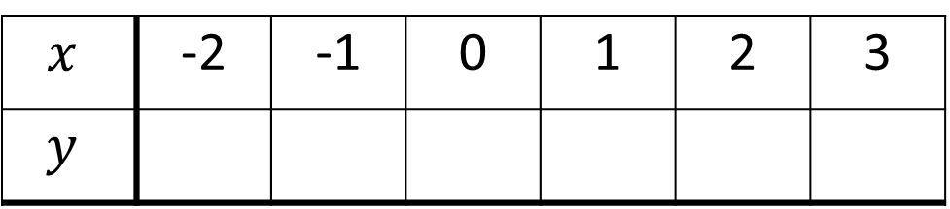
24
7
30
Date
Linear Relationships
EQ – How do you draw a graph from a table?
Coordinates can also be written in a table to organise them and make them easier to graph.
Consider the following set of coordinates:
(0, -2) (3, 1) (-1, -3) (1, -1) (-2, -4) (2, 0)
Step 1: Put them in order by the x-value (first number)
(-2, -4) (-1, -3) (0, -2) (1, -1) (2, 0) (3, 1)
Step 2: Place the x values in the table, ensuring they go up by the same amount each time.
Step 3: Place the corresponding y values in the table.
What are the steps to placing coordinates in a table?
$$x$$ | -2 | -1 | 0 | 1 | 2 | 3
$$y$$
11

Slide 7
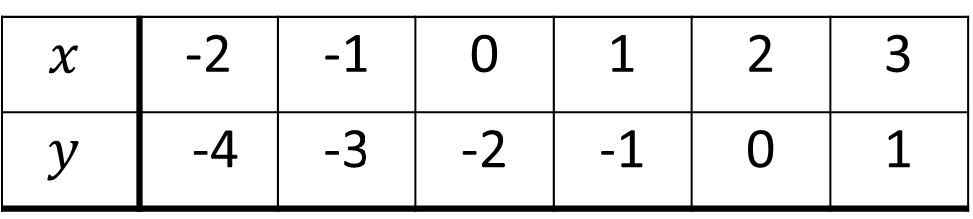
24
7
30
Date
Linear Relationships
EQ – How do you draw a graph from a table?
Coordinates can also be written in a table to organise them and make them easier to graph.
Consider the following set of coordinates:
(0, -2) (3, 1) (-1, -3) (1, -1) (-2, -4) (2, 0)
Step 1: Put them in order by the x-value (first number)
(-2, -4) (-1, -3) (0, -2) (1, -1) (2, 0) (3, 1)
Step 2: Place the x values in the table, ensuring they go up by the same amount each time.
Step 3: Place the corresponding y values in the table.
What are the steps to placing coordinates in a table?
$$x$$ | -2 | -1 | 0 | 1 | 2 | 3
$$y$$ | -4 | -3 | -2 | -1 | 0 | 1
11

Slide 8
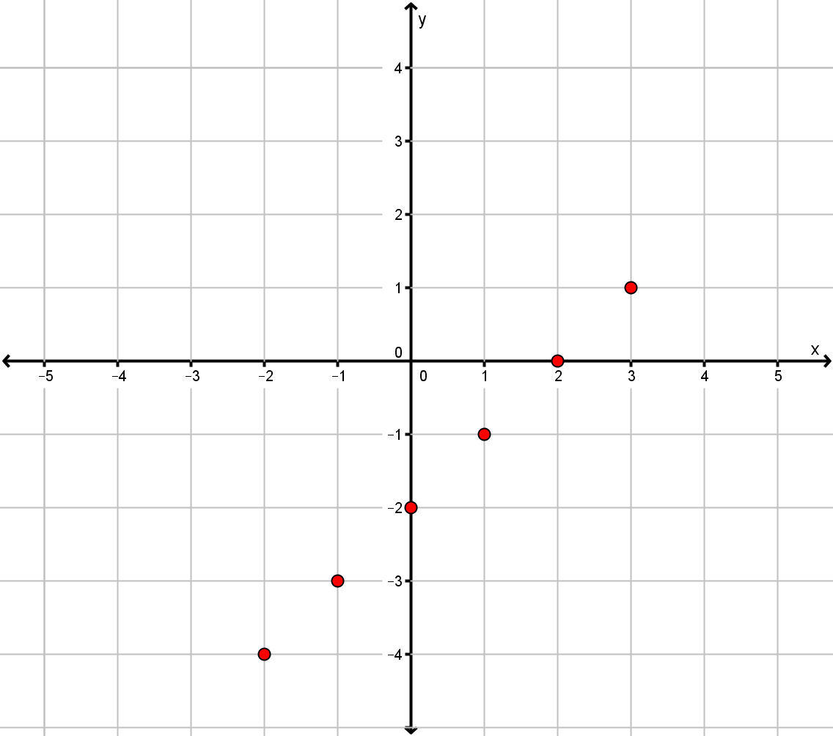
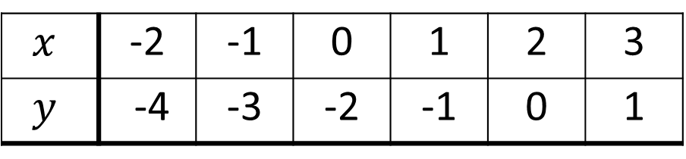


24
7
30
Date
Linear Relationships
EQ – How do you draw a graph from a table?
How do we graph linear coordinates?
Plot each pairs of numbers in the table as if they were coordinates and then join them up with a straight line (with arrows at the end).
$$x$$ | -2 | -1 | 0 | 1 | 2 | 3
$$y$$ | -4 | -3 | -2 | -1 | 0 | 1
$$y$$
$$x$$
11

Slide 9

Do you understand?
Notes:
Check for Understanding

Slide 10
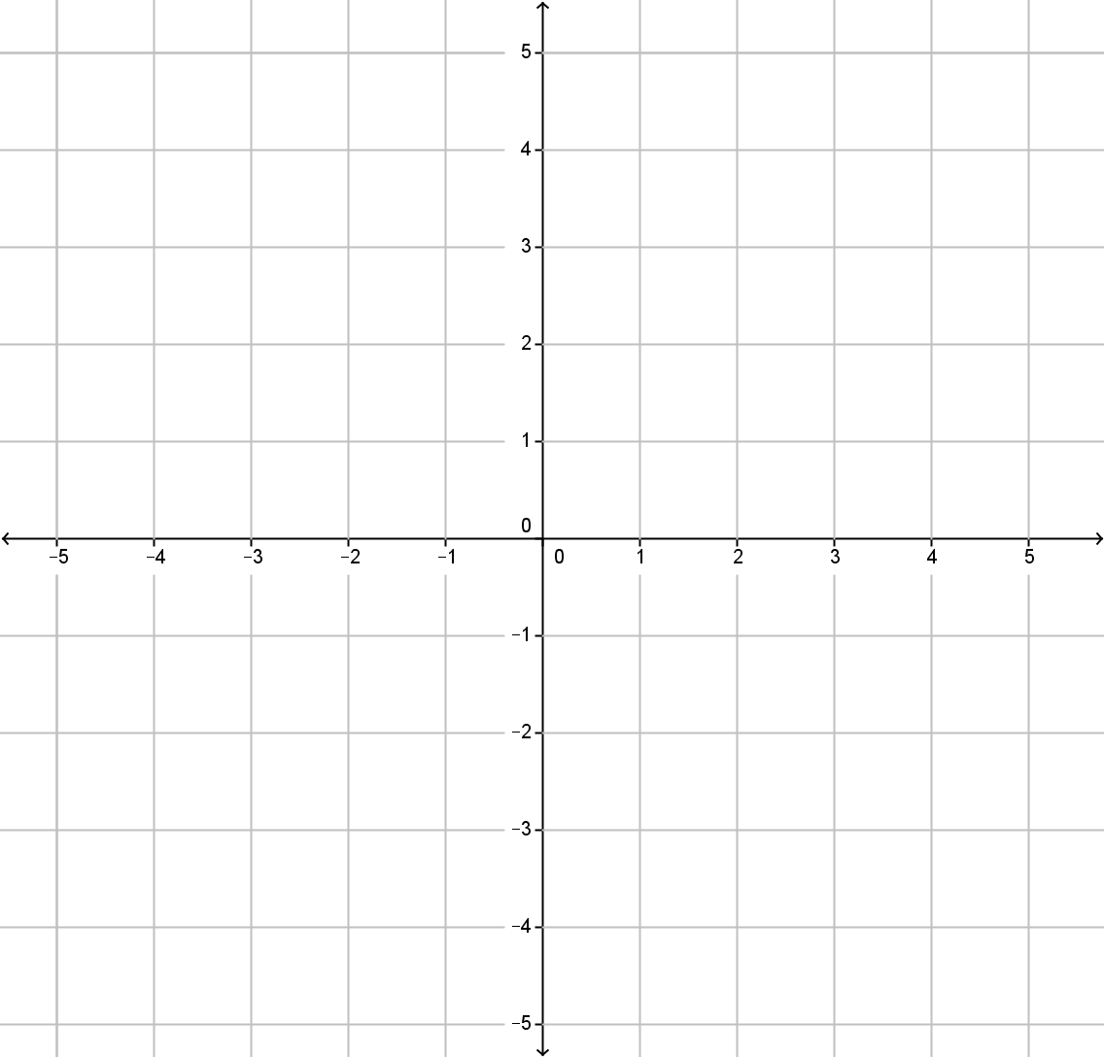
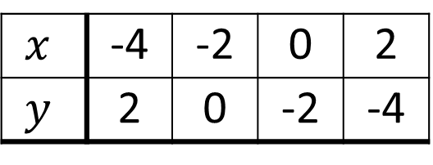

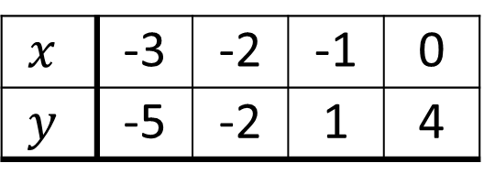
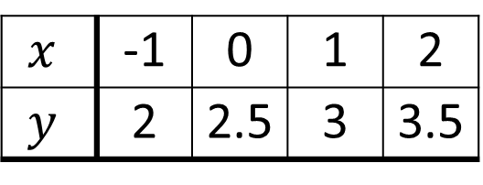
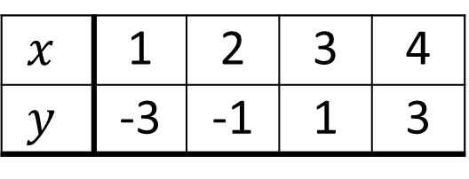

Your Turn (LHS of course)
Draw a coordinate grid from -5 to 5 on both axes (as below) and plot the following tables of coordinates.
(a)
$$y$$
$$x$$ | 1 | 2 | 3 | 4
$$y$$ | -3 | -1 | 1 | 3
(b)
$$x$$ | -1 | 0 | 1 | 2
$$y$$ | 2 | 2.5 | 3 | 3.5
$$x$$
(c)
$$x$$ | -3 | -2 | -1 | 0
$$y$$ | -5 | -2 | 1 | 4
(d)
$$x$$ | -4 | -2 | 0 | 2
$$y$$ | 2 | 0 | -2 | -4

Slide 11
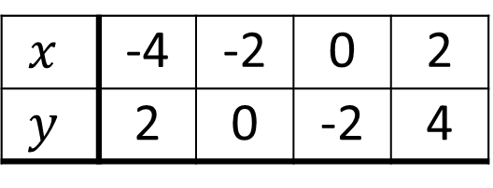
Your Turn (LHS of course)
Draw a coordinate grid from -5 to 5 on both axes (as below) and plot the following tables of coordinates.
(a)
$$y$$
(a)
$$x$$ | 1 | 2 | 3 | 4
$$y$$ | -3 | -1 | 1 | 3
(b)
$$x$$ | -1 | 0 | 1 | 2
$$y$$ | 2 | 2.5 | 3 | 3.5
$$x$$
(c)
$$x$$ | -3 | -2 | -1 | 0
$$y$$ | -5 | -2 | 1 | 4
(d)
$$x$$ | -4 | -2 | 0 | 2
$$y$$ | 2 | 0 | -2 | 4

